Slide 1
GROUP 10
Sri Lalana
Parsis Presswala
Trapti Khandelwal

Slide 2
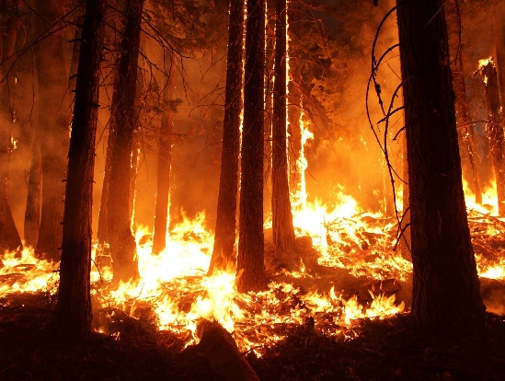

Our Projects
Predict the Burned Area of Forest Fires
Description :- Forest fire causes serious damage to the Flora and fauna of a country. This is one of major environmental concerns. The aim of this project is to predict the burned area of forest fires, in the northeast region of Portugal, by using meteorological and other data.
Prediction of Movie Genre
  Description :- Genre categorizes movies. Categorizing movies makes it easier for the viewer to discover what he or she likes and will want to see. Putting a movie into a particular genre or category does not diminish the quality of the movie. Movies often have genres that overlap, such as adventure in a spy movie, or crime in a science fiction movie. But one genre is predominant.

Slide 3
Prediction of Forest Fire
Problem Type - Regression Problem
Purpose - To help the fire management team in proper resource allocation and to help the firefighters in the best possible way
Number of rows – 517
Number of Attributes – 13
Response Variable – Area
Predictors – X, Y, Month, Day, FFMC, DMC, DC, ISI, temp, RH, wind,rain

Slide 4
Approach to the Project
Data Cleaning –
  Since, there were no null values in dataset, so we added 10% null values of data.
  Then, we filled our null values using fillna method.
  Since, month and day were categorical variables, so we have used One Hot Encoding(get_dummies) in order to convert them to numerical values.
Splitting Dataset to Training and Testing part.
Applying different regression techniques.
Comparing different models.
Selection of best model.

Slide 5
Regression Algorithms – Linear
Linear Regression
RMSE of test data : 88.07951720551468
RMSE of train data : 45.18894615306514
Ridge
RMSE of train data: 47.3163218402544
RMSE of test data: 87.13819665082845
Lasso
RMSE of train data: 47.52113392544899
R Score for test data : 0.038134881482222105
R score of train data: 0.035124596020331134
R Score of test data: 0.014007270500274949
R score of test data: 0.008213465827488609
RMSE of test data: 87.39383859971166
R score of train data: 0.02675345313020039

Slide 6
Regression Algorithms – Non-Linear
Random Forest
RMSE of test data: 87.73526113401071
R score of test data: 0.00044908061671278254
Decision Tree
RMSE of test data: 89.24689821929452
RMSE of train data: 39.77601922
Bagging -KNN
RMSE of test data: 88.20597729189615
RMSE of train data: 44.79670302602571
RMSE of train data: 19.806496060611288
R score of test data: -0.005991013431708936
R score of test data: -0.0103052486123969

Slide 7
Regression Algorithms – Non-Linear
XG - Boost
R score of test data: -0.00640
Gradient Boosting
RMSE of test data: 90.195706
R score of train data: 0.49881935183490445
SVM
R score of test data: -0.02302810224396068 (kernel = rbf)
R score of test data: -0.023126894179711366 (kernel = linear)
RMSE of train data: 33.774254
R score of test data: -0.031858486774096084
R score of test data: -0.02795675849963386 (kernel = poly)
R score of test data: -0.027858613754495384 (kernel = sigmoid)

Slide 8
Conclusion
As we can see that both linear and non linear techniques are not giving appropriate results for the dataset ,which clearly indicates that the dataset taken is unable to find the patterns .So this can be considered as one of those situations where Machine learning algorithms cannot work.¶

Slide 9
Prediction of Movie Genre
Problem Type - Classification Problem
Purpose – To classify the genre based on the movie plot which helps the audience to make choices accordingly.
Number of rows – More than 5500
Number of Attributes – 8
Response Variable – Genre
Predictors – Synopsis

Slide 10
Approach to the project
Data cleaning –
  Dropped the null values of dataset, since there were not much null values.
  Cleaning of Synopsis column mean removing all whitespaces, commas, apostrophes etc.
Since, genre is in text format, so converting the text into features.
Splitting Dataset into Training and Testing part.
Apply different classification and multi-label classification algorithms because genre is multi-label data.
Comparing different models.
Selection of the best model.

Slide 11
Classification Algorithms
Logistic Regression
F1 Score is: 0.5782530204138314
Decision Tree
F1 score is: 0.40107939213179944
The Accuracy is: 0.09260588657573582
The Accuracy is: 0.11486001435750179
Precision: 0.5689655172413793
Recall: 0.5977253580454929
Precision: 0.47600349040139617
Recall: 0.45956192080876157

Slide 12
Multi-Label Classification Algorithms
Binary Relevance
The Accuracy is: 0.09257265877287406
Recall: 0.35720303285593935
Classifier Chains
The Accuracy is: 0.09472551130247578
Precision: 0.5307262569832403
Label Powerset
The Accuracy is: 0.17115177610333693
Precision: 0.5381508078994613
The F1Score is: 0.42516921534219104
Precision: 0.525077399380805
The F1Score is: 0.42910915934755334
Recall: 0.36015164279696715
The F1Score is: 0.521077792264233
Recall: 0.5050547598989048
Adapted Algorithm
The Accuracy is: 0.08934337997847147
The F1Score is: 0.48275862068965525
Precision: 0.6277815239379636
Recall: 0.3921651221566976

Slide 13
Conclusion
We have applied different approaches using different methods. Here we got maximum accuracy from label powerset with 17%, but we can not consider it in multilabel classification. So we will evaluate our model with macro and micro F1 Score, Precision and Recall. We got maximum F1 score from Logistic Regression with One vs Rest method with 58%. So we got best model from Logistic Regression with One vs Rest method.

Slide 14
THANK YOU

